Slide 1


Investment Analysis for Spark Funds
Spark Funds, a venture capital firm, is seeking to invest between 5 to 15 million USD in promising startups. This analysis aims to identify the most suitable investment opportunities by examining the appropriate funding types, top investment destinations, and key sectors attracting the highest investments.
by Angeline A

Slide 2

Investment Type Analysis
Venture
Private Equity
Debt Financing
The analysis identified venture funding as a suitable option, with an average investment of 8.91 million USD, falling within Spark Funds' desired range.
Private equity funding also emerged as a viable choice, with an average investment of 9.23 million USD.
Debt financing, with an average investment of 8.26 million USD, is another funding type that aligns with Spark Funds' investment criteria.

Slide 3
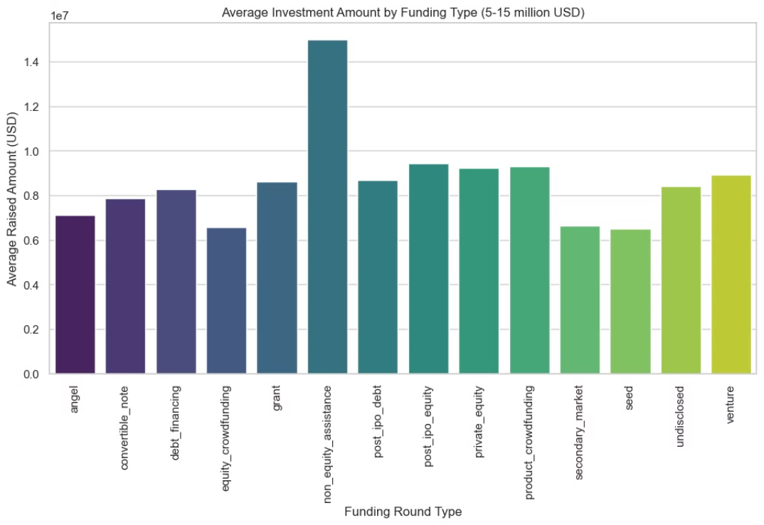
Total Investment Amount by Funding Type (5 - 15 million USD)

Slide 4
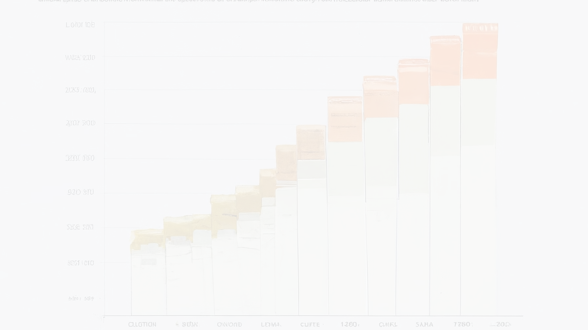
Country Analysis
United
Kingdom
1
2
3
Canada
USA
The USA stands out as the top investment destination, receiving a total of 122.40 billion USD in investments.
The United Kingdom (GBR) is the second-largest recipient of investments, with 6.56 billion USD.
Canada (CAN) is the third-largest investment destination, attracting 4.35 billion USD.

Slide 5
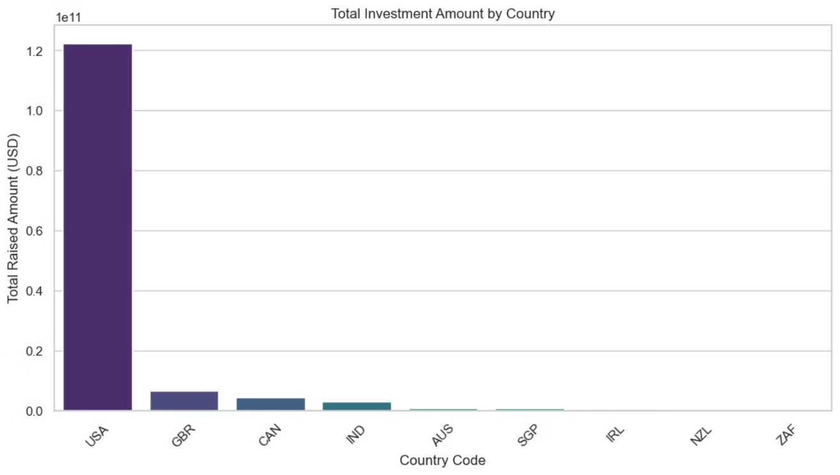
Total Investment Amount by Country

Slide 6

Sector Analysis
Others
Cleantech /
Semiconductors
The "Others" sector has received the highest investment, totaling 23.55 billion USD.
The Cleantech / Semiconductors sector has attracted 21.78 billion USD in investments.
Health
The Health sector has received 7.16 billion USD in investments.

Slide 7
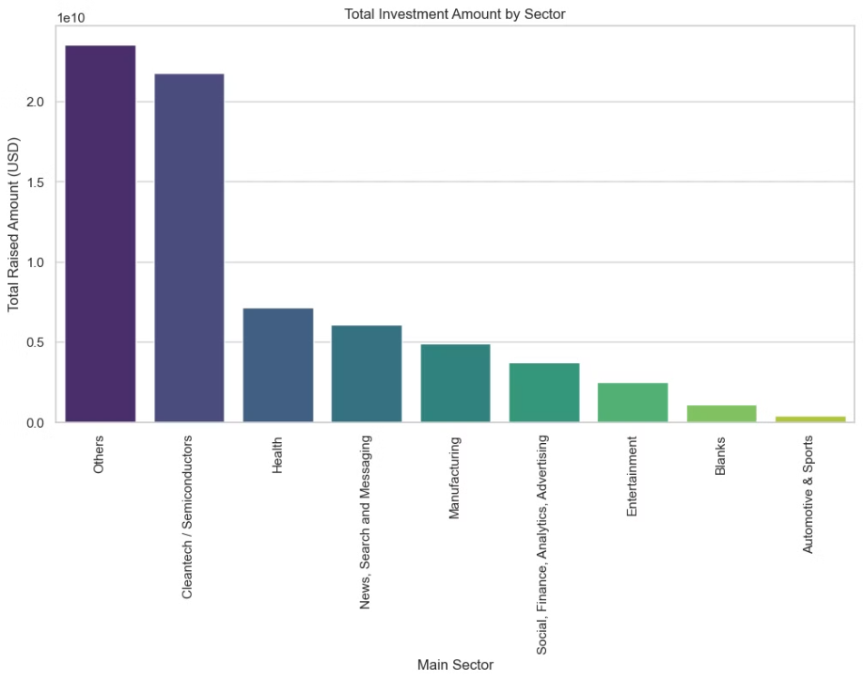
Total Investment Amount by Sector

Slide 8




Recommendations
Investment Type
Country
Sector
Venture and Private Equity funding types are highly recommended, as they fall within the desired investment range and have substantial average investment amounts.
The USA, United Kingdom, and Canada are the top investment destinations and should be the focus for high-potential opportunities.
Investing in the Cleantech / Semiconductors and Health sectors is advisable, as they have received considerable funding historically.

